Slide 1
Project 2 (P170)
Hotel Rating Classification

Slide 2
Group - 4
Miss . Shobha.M
Ms. Neha Kumari
Ms. Dhanashree Vijaykumar Shitole
Miss. Chadive Pallavi
Ms.Shruti Tanaji Jadhav
Mr. Preetham Shetty
Mr. Keerthi Kumar D Kadlajji

Slide 3
Agenda 1
Exploratory Data Analysis (EDA),
Data Cleaning

Slide 4
Problem Statement
In this project, our goal is to examine how travelers are communicating their positive and negative experiences in online platforms for staying in a specific hotel.
Our major objective is what are the attributes that travelers are considering while selecting a hotel.
With this manager can understand which elements of their hotel influence more in forming a positive review or improves hotel brand image.

Slide 5
Data Cleaning
The shape of dataset is 20419 rows and 2 columns.
Review and Ratings.
Review is object and Ratings is int64.
Ratings are given on the scale of 1 to 5, Where 5 is the highest and 1 is the least rating.

Slide 6
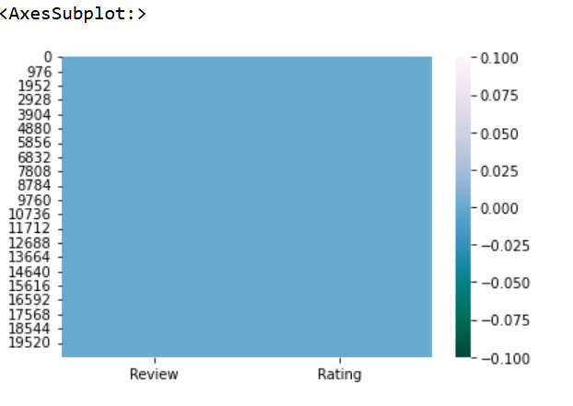
Finding the missing value and Duplicate value
Inference
We can see the heatmap.
Here there is no null value.
In this dataset there is no duplicate value.

Slide 7
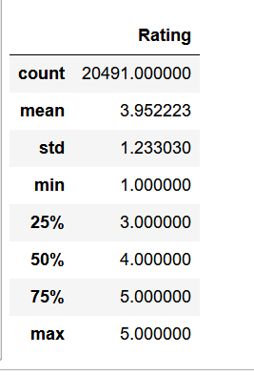
Data summary or Descriptive Statistics
Inference
Descriptive Statistics:
Mean is 3.95.
Standard deviation is 1.23.
Min is 1.00.
In this summary we can see that 75% and max is 5.00.

Slide 8
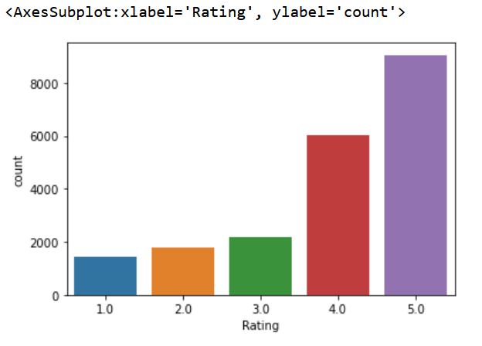
Exploratory Data Analysis(EDA)
Inference from Bar graph
From Bar graph, we can say that count of ratings for 4, 5 are comparatively much higher than the other rating scores.
Hence, we can say for our data that most of the users are highly satisfied with their experience at hotels.

Slide 9
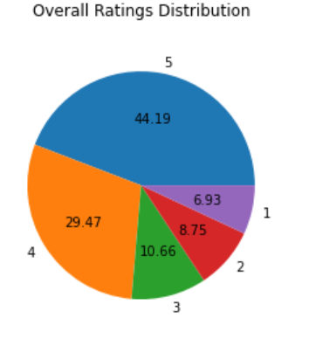
Inference from Pie Chart
5 = 44.19%
4 = 29.47%
3 = 10.66%
2 = 8.75%
1 = 6.93%

Slide 10
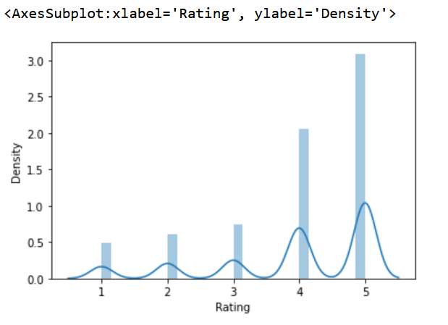
Inference from distplot
From distplot , we can say that almost 75% of reviews are rated (5, 4) by users and remaining 25% reviews are rated (3, 2, 1).
We have an unequal distribution of data, where we have less no. of negative ratings provided by users.

Slide 11
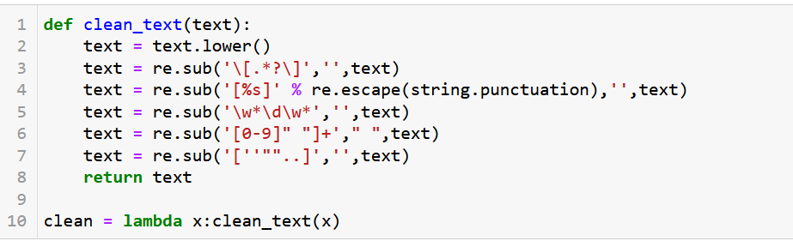
Data cleaning
Lower case
Removes brackets
Punctuation
Numbers

Slide 12
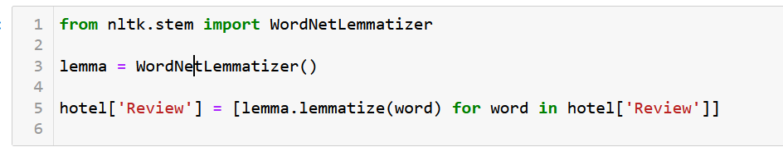
# Apply Stemming & Lemmatization
Stemming
Lemmatization

Slide 13
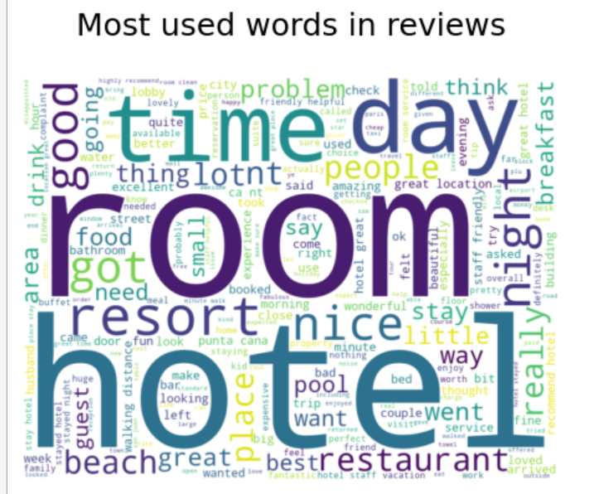
Generate wordcloud
Plotting the wordcloud on original data for all ratings
Inference from wordcloud
Hotel, room, time, resort, beach, day, night, & people etc. were most commonly used words in overall reviews by users.

Slide 14
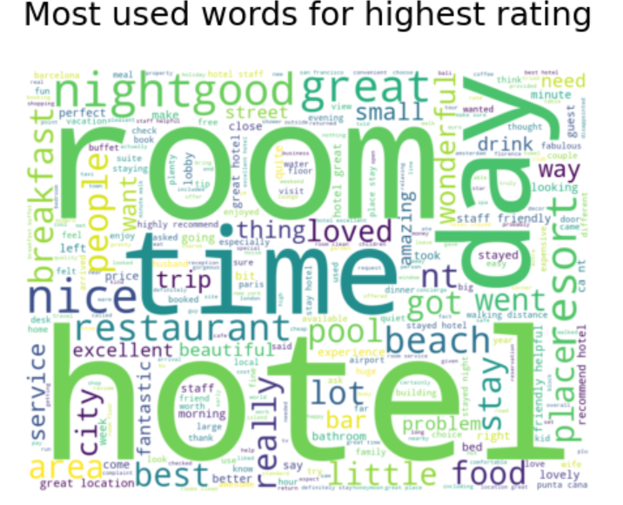
Plotting the wordcloud on original data for all highest rating (5)
Inference from wordcloud
Great, nice, wonderful, good, loved, restaurant, hotel, room, day, etc. were some frequently used words by users who rated for score of 5, it seems they had a delightful experience at hotel.

Slide 15
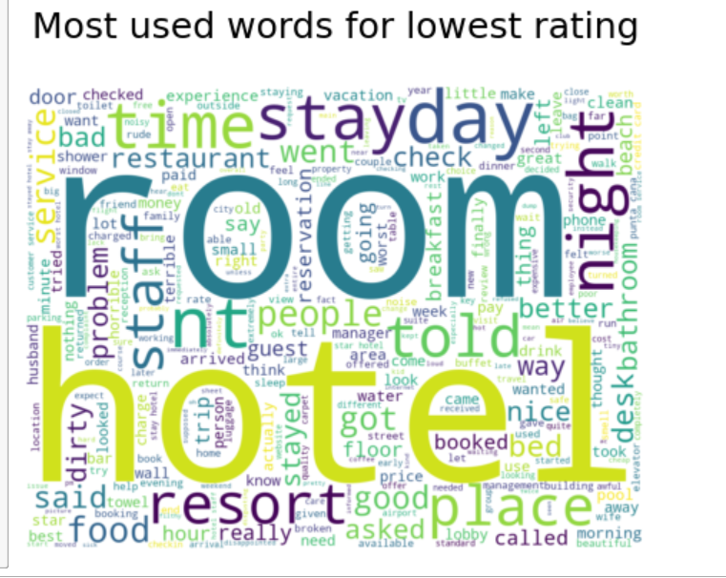
Plotting the wordcloud on original data for all Lowest rating (1)
Inference from wordcloud
The users who were not happy or rated low for their experience have used Service, problem, staff, desk, better, told, dirty, bad, day, hotel, room, food etc. these words frequently in their reviews.

Slide 16
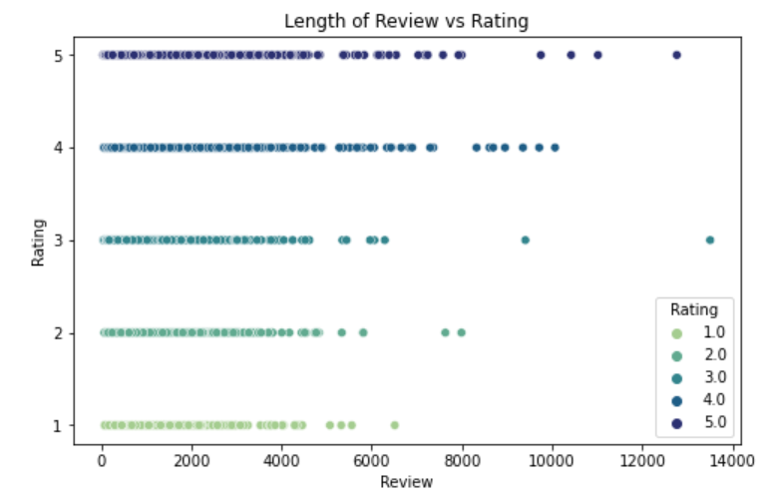
Checking the length of words in a review for all the rating
Inference from scatterplot
From scatterplot, we can say that the length of review has an effect on ratings.
Lower ratings have lower length of review compared to top ratings.
Hence, there exists a positive correlation between Length of Reviews & Ratings.

Slide 17
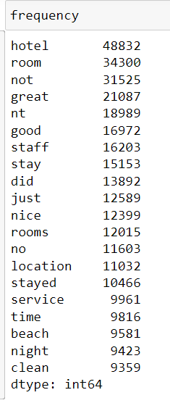
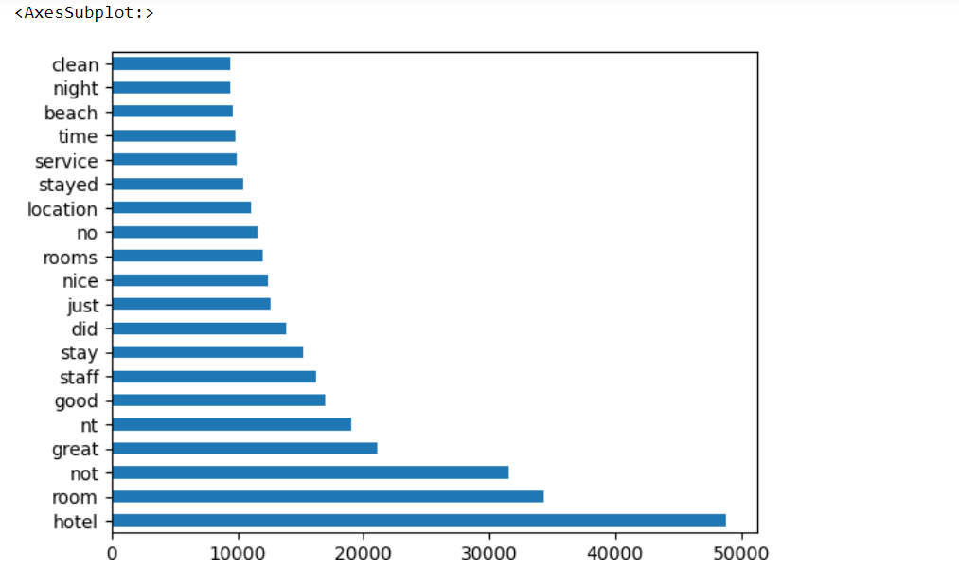
Frequency count of words before stop word removal.
Inference
In this Frequency plot we can see that there are words like clean, night, beach, time, service, stayed, location, no, rooms etc..

Slide 18
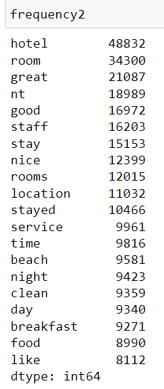
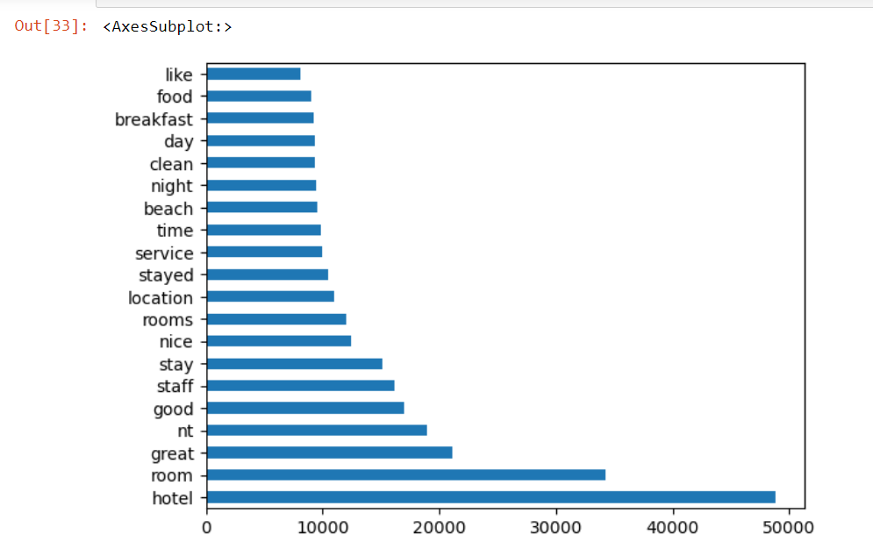
Frequency count of words After stop word removal
In this frequency2 after removal of stop wards we have words like, food, breakfast, day, clean, night, beach, time, service, stayed, location, rooms etc....

Slide 19
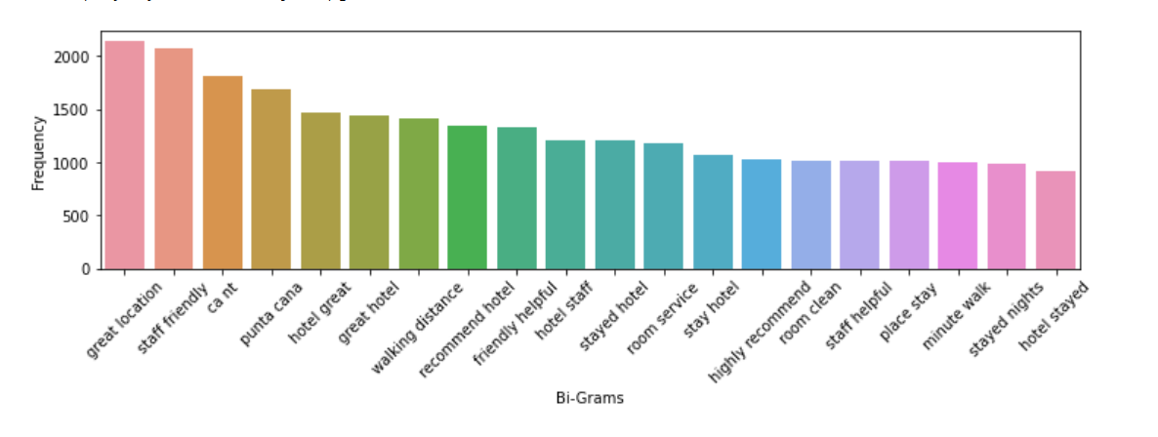
Bi-gram for top 20 words
Inference
Using N-Gram we have got the top 20 Bigram in the text which can be useful for the review analysis and knowing the context of words which customers are using frequently.

Slide 20
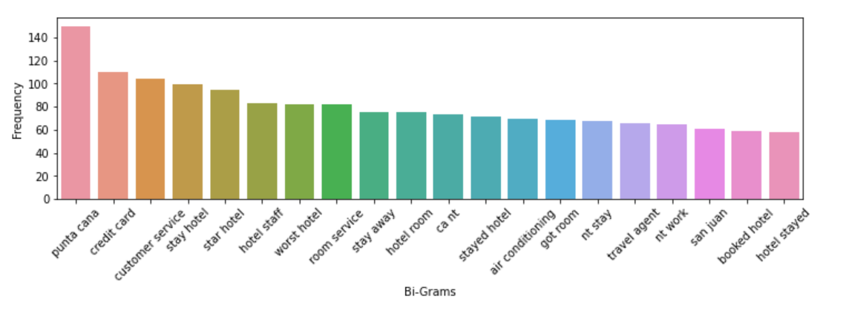
Bi-Gram for 1 star
Inference
Using N-Gram we have got the top 20 Bigram for 1 Star Reviews in the text which can be useful for the review analysis and knowing the context of words which customers are using frequently.

Slide 21
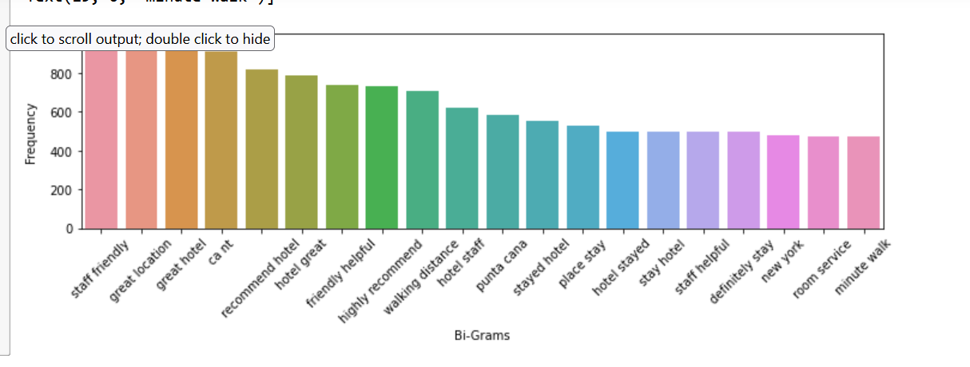
Bi-Gram for 5 star
Inference
Using N-Gram we have got the top 20 Bigram for 5 Star Reviews in the text which can be useful for the review analysis and knowing the context of words which customers are using frequently.

Slide 22
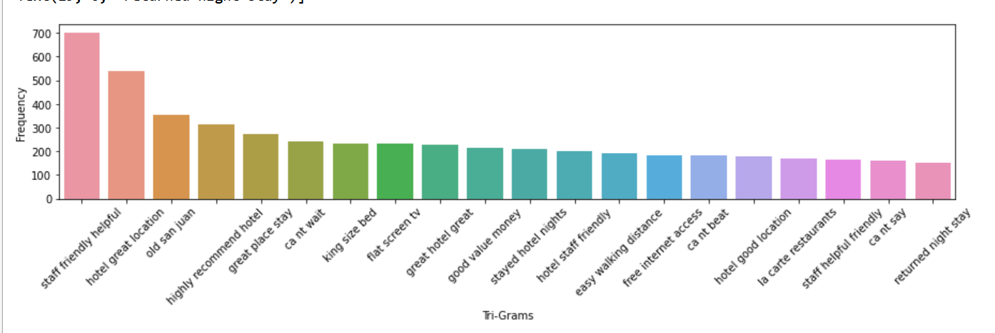
Tri-gram for top 20 words
Inference
Using N-Gram we have got the top 20 Trigram in the text which can be useful for the review analysis and knowing the context of words which customers are using frequently.

Slide 23
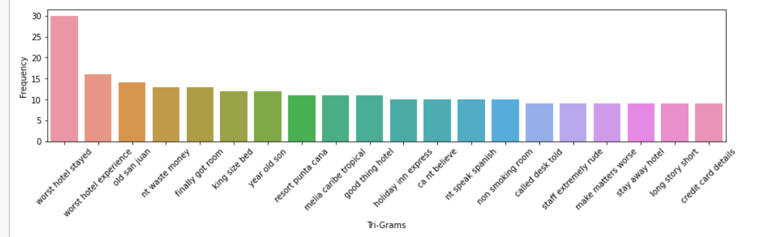
Tri-gram for 1 star
Inference
Using N-Gram we have got the top 20 Trigram for 1 Star Reviews in the text which can be useful for the review analysis and knowing the context of words which customers are using frequently.

Slide 24
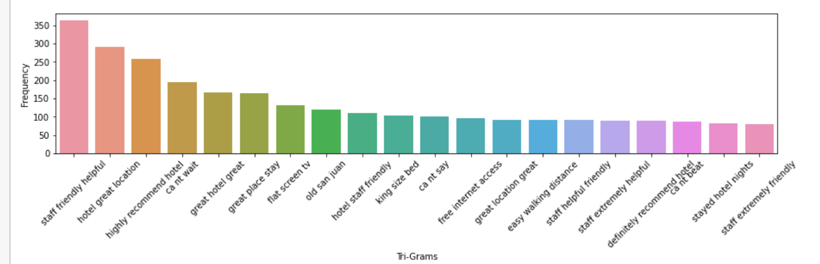
Tri-gram for 5 star
Inference
Using N-Gram we have got the top 20 Trigram for 5 Star Reviews in the text which can be useful for the review analysis and knowing the context of words which customers are using frequently.

Slide 25
Agenda 2
–
Model Building

Slide 26
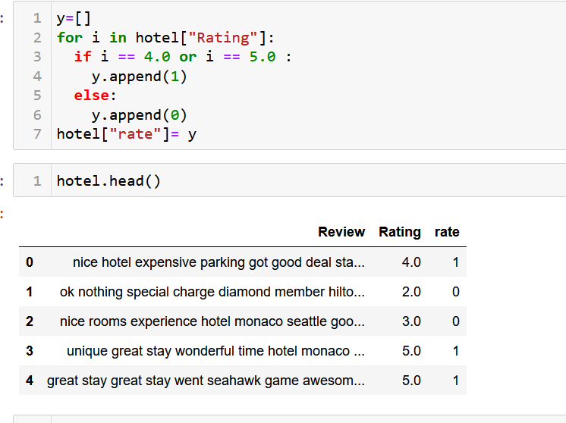
Train and Test Split
We have use Bag of words
Taken max feature is 1500
Ratings classification
If 4 or 5 means 1.
Less than 4 is 0.

Slide 27
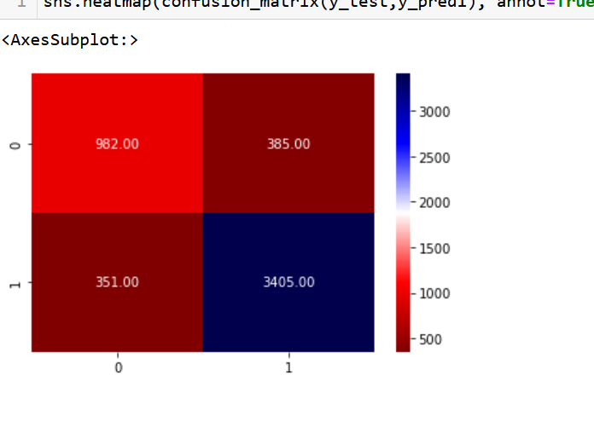
Model 1 - Naive Bayes Algorithm
Using Naïve Bayes with Train and Split method
Accuracy is 85.63%

Slide 28
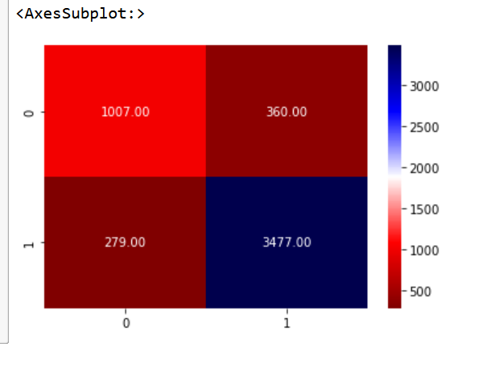
Model 2 - Logistic Regression Algorithm
Using Logistic Regression with Train and Split method
Accuracy is 87.52%

Slide 29
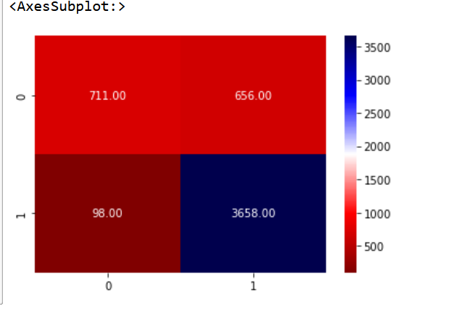
Model 3 - Random Forest Algorithm
Using Random Forest with Train and Split method
Accuracy is 85.28%

Slide 30
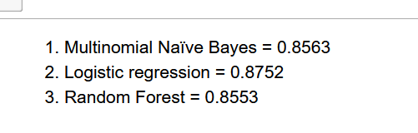
Comparing the Accuracy of all the Models
Logistic regression is at best – 87.52%

Slide 31
Effective Ways To Attract Hotel Customers.
Impress Visitors before their arrival.
Maintain the Excellent Room Services.
Offer better rates with re-recreational facilities.
Establish an online presence.
Take an advantage of social media.
Build customer loyalty program.

Slide 32
Agenda 3
–
Model Pipeline and Deployment Using Streamlit

Slide 33
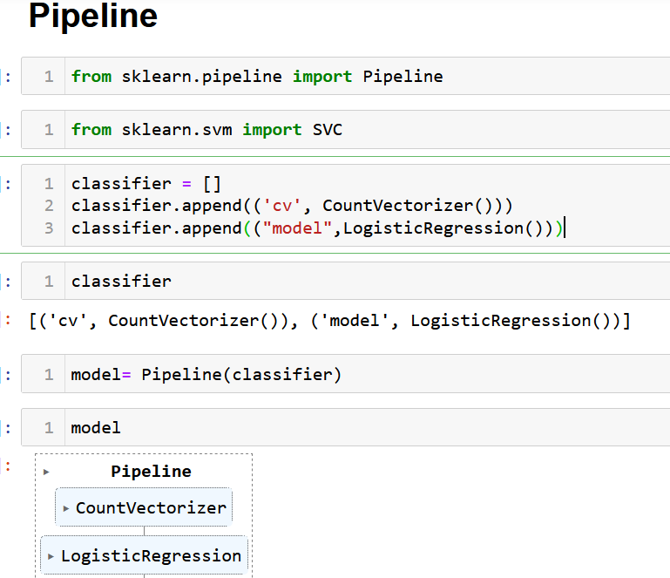
Logistic regression Classifier Pipeline
Pipeline CountVectorizer and LogisticRegression

Slide 34
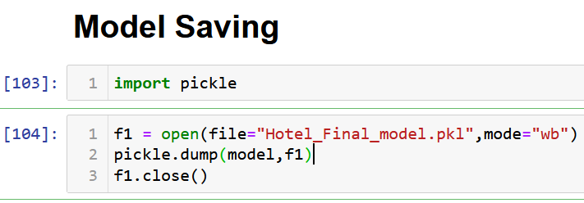
Saving the Model using Pickel
LogisticRegression Model Saved as
Hotel_Final_model.pkl

Slide 35
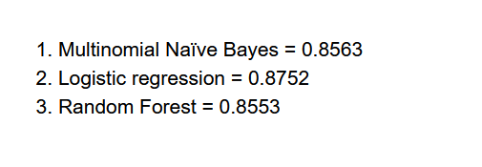
As per the Accuracy Chart below, We have finalized LogisticRegression Classifier and Deploying the Model

Slide 36
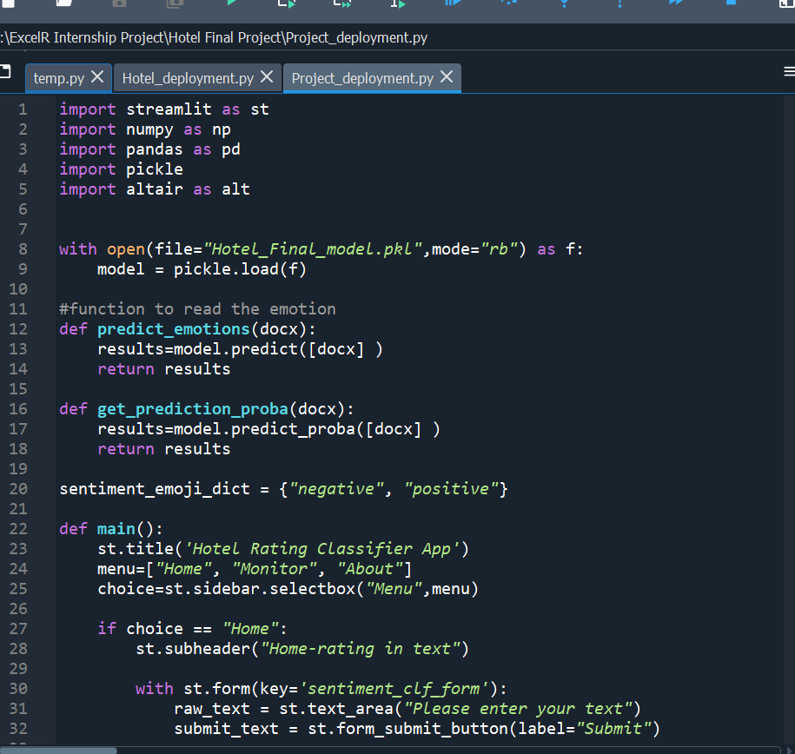
PY File Creation Using Spyder (Python 3.9)
We have created the PY file where we are calling the saved model and the input variables and Predicting based on the User Inputs.

Slide 37
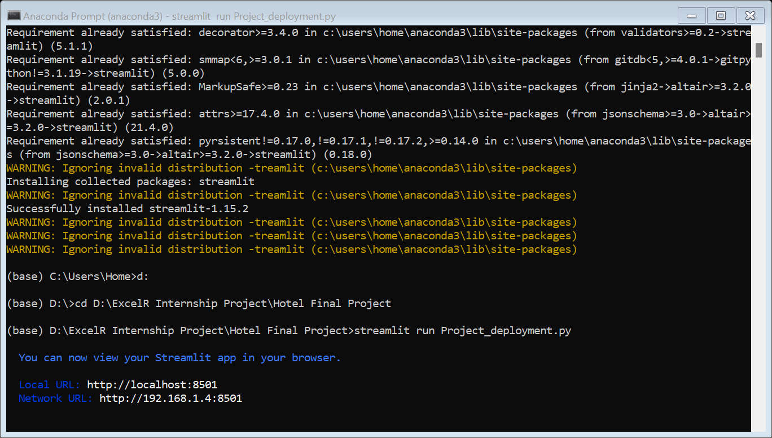
Running the PY file through Anaconda Prompt

Slide 38
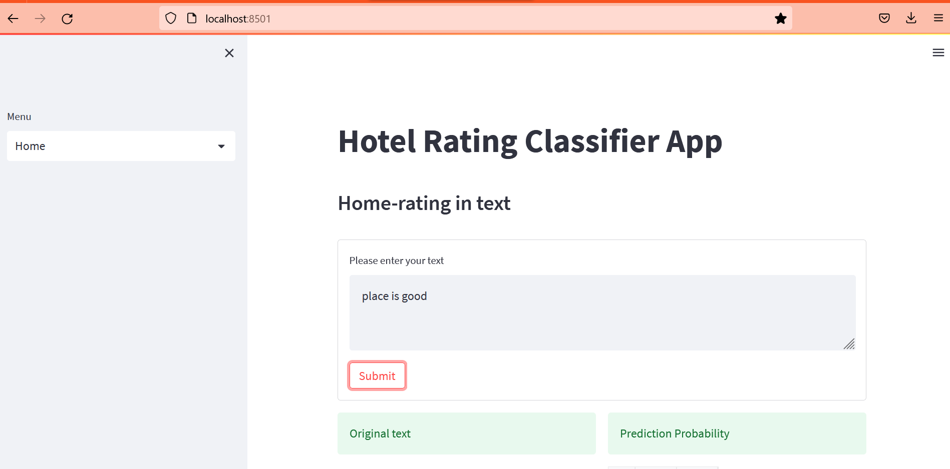
FINAL DEPLOYED MODEL
With Input Variables on left and Predictions and Probability on right

Slide 39
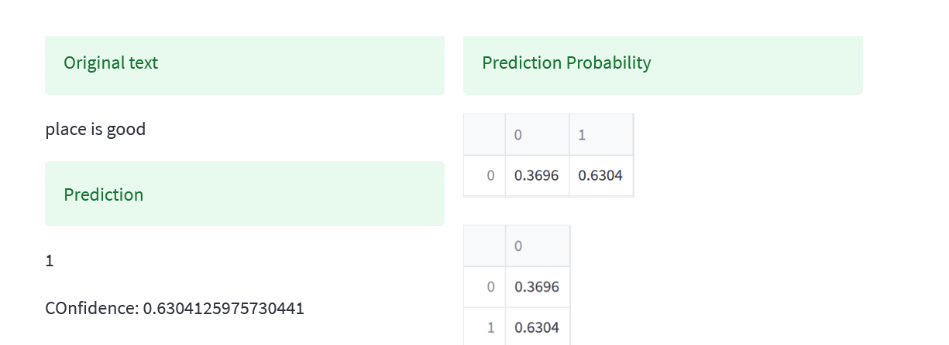
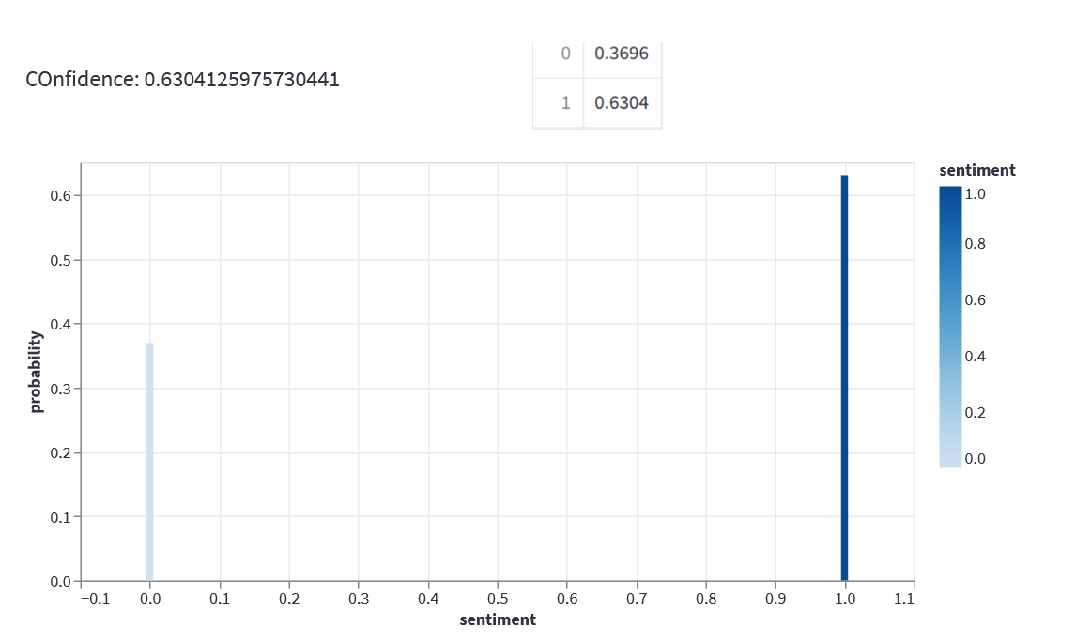

Slide 40
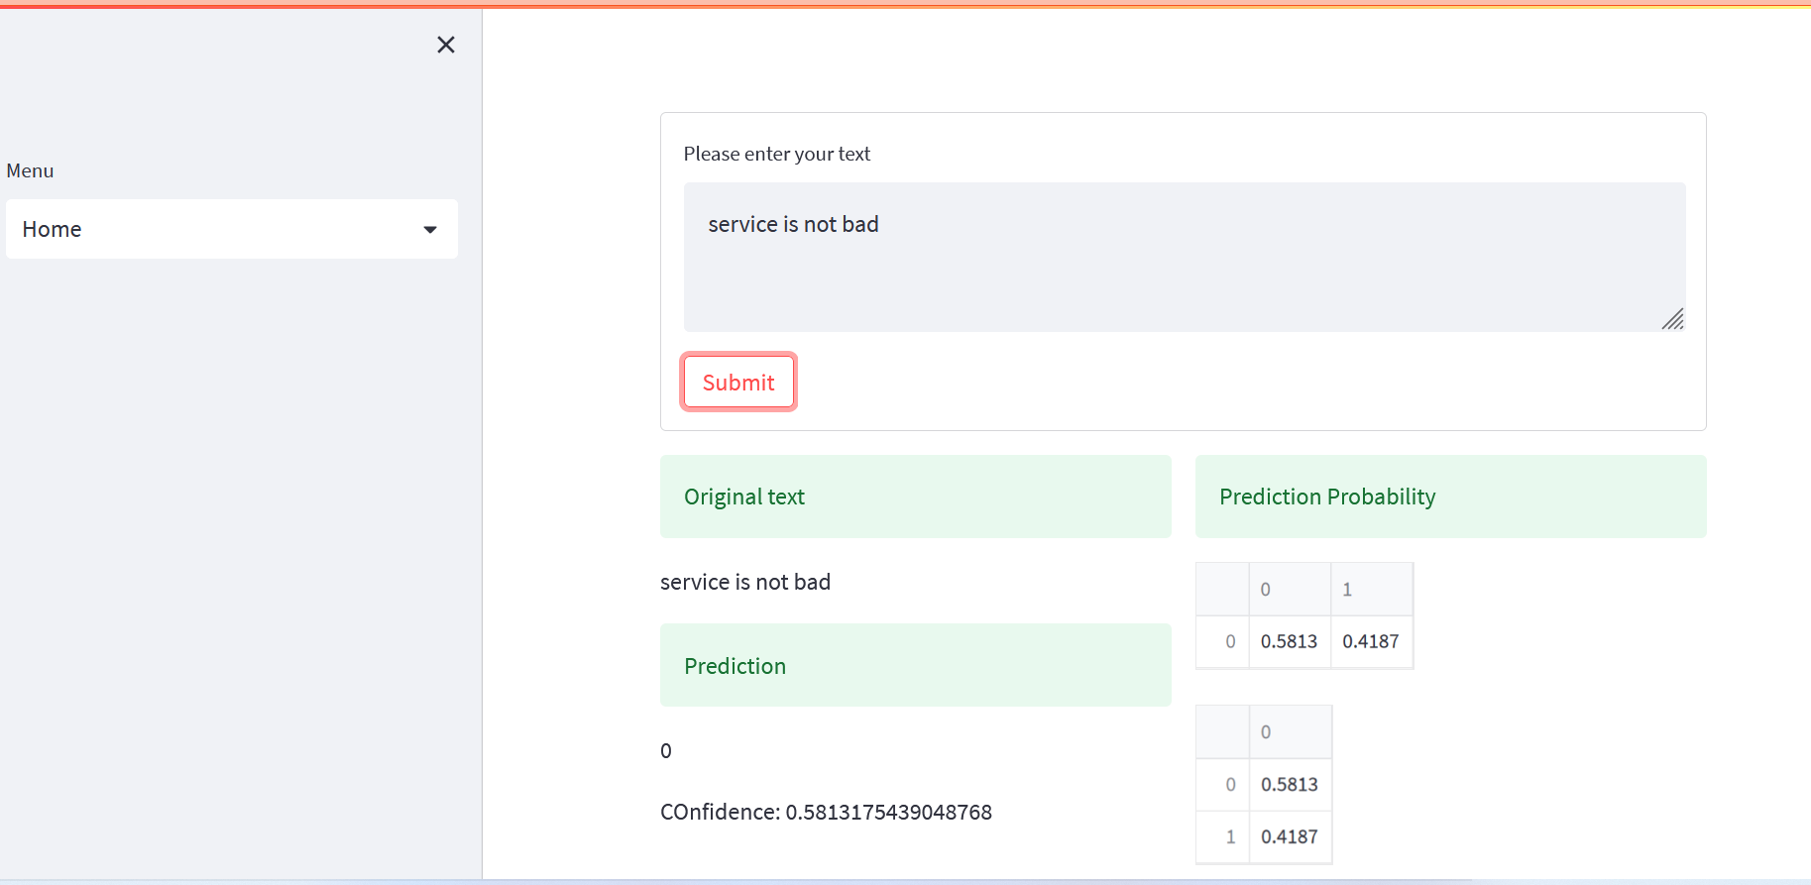

Slide 41
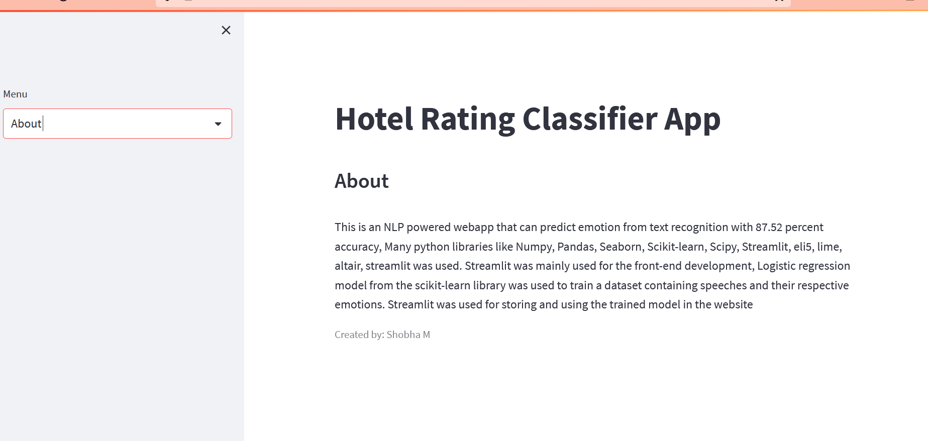

Slide 42


